Slide 1
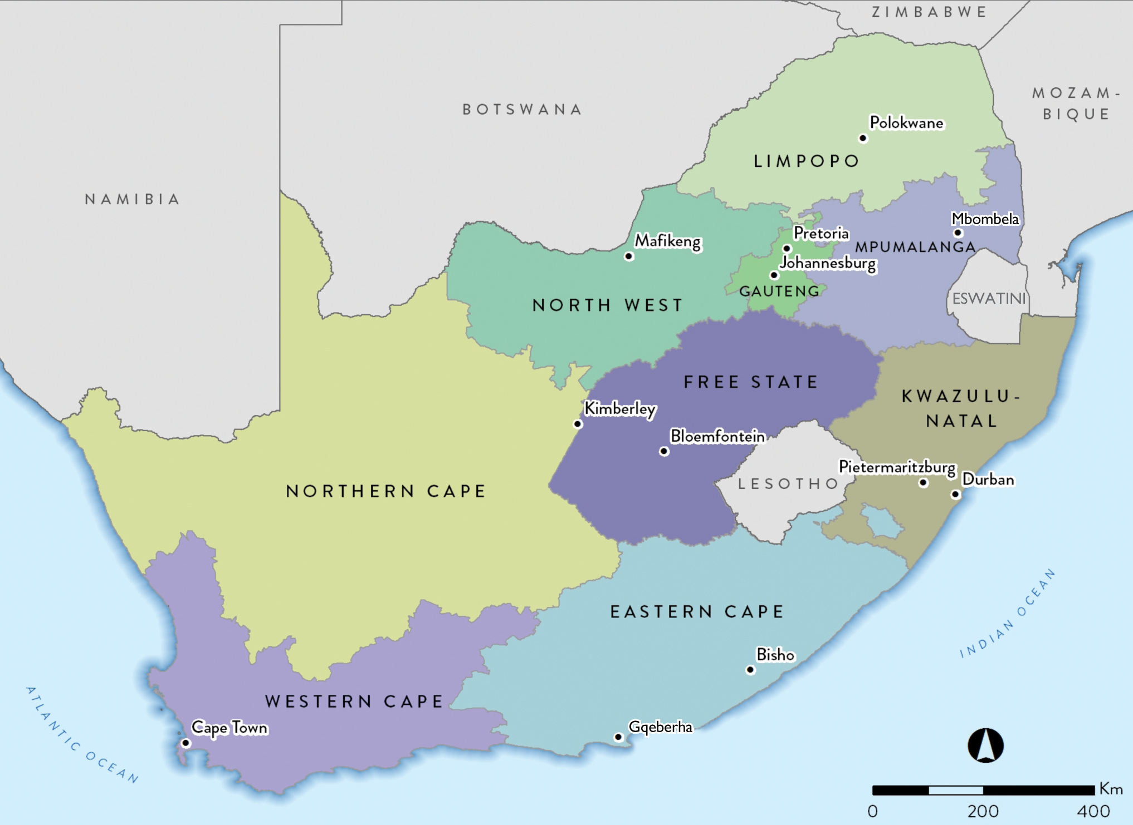
58.78 million

Slide 2
Population data by ethnic group
Population group | Million | %
Black | 47.44 | 80.7
Coloured (mixed ancestry) | 5.18 | 8.8
White | 4.65 | 7.9
Indian/Asian | 1.50 | 2.6
Total | 58.78 | 100

Slide 3
Population data by province
Province | Million | %
Eastern Cape (EC) | 6.71 | 11.4
Free State (FS) | 2.89 | 4.9
Gauteng (GT) | 15.18 | 25.8
KwaZulu-Natal (KZN) | 11.29 | 19.2
Limpopo (LP) | 5.98 | 10.2
Mpumalanga (MP) | 4.59 | 7.8
North West (NW) | 4.03 | 6.9
Northern Cape (NC) | 1.26 | 2.2
Western Cape (WC) | 6.84 | 11.6
Total | 58.78 | 100

Slide 4
Number of treatment centres by province and sector
Sector | EC | FS | GT | KZ | LP | MP | NW | NC | WC | All
Public | 4 | 7 | 7 | 6 | 1* | 0 | 3 | 1 | 5 | 34
Private | 22 | 14 | 78 | 63 | 14 | 15 | 12 | 5 | 34 | 257
Total | 26 | 21 | 85 | 69 | 15 | 15 | 15 | 6 | 39 | 291
* This centre is a public-private initiative on the premises of Polokwane Provincial Hospital.

Slide 5
Prevalence (pmp) and numbers of patients on KRT by province
Province | EC | FS | GT | KZ | LP | MP | NW | NC | WC | All
Patients | 1114 | 565 | 3 204 | 1 921 | 327 | 247 | 356 | 169 | 2 034 | 9 937

Slide 6
KRT prevalence (pmp) by healthcare sector
 | Public | Private
Population in millions | 49.79 | 8.99*
Patients on treatment | 2 860 | 7 077
Treatment rate (pmp) | 57 | 788
* Council for Medical Schemes Annual Report 2019/20

Slide 7
Numbers of patients by province and sector
Sector | EC | FS | GT | KZ | LP | MP | NW | NC | WC | All
Public | 319 | 256 | 826 | 264 | 85 | 56 | 94 | 89 | 871 | 2 860
Private | 795 | 309 | 2 378 | 1 657 | 242 | 191 | 262 | 80 | 1 163 | 7 077
Total | 1114 | 565 | 3204 | 1921 | 327 | 247 | 356 | 169 | 2034 | 9 937

Slide 8
KRT prevalence (pmp) by province and sector
Notes:
Adjusted for unclassified medical aid beneficiaries

Slide 9
Distribution of patients by treatment modality
Modality | Patients | %
Haemodialysis | 7 060 | 71.1
Peritoneal dialysis | 969 | 9.8
Transplant | 1 908 | 19.2

Slide 10
KRT modality by sector
Public
12.3%
Private
4.3%
36.2%
40.5%
83.4%
23.3%
Treatment modality | Public sector |  | Private sector
 | Patients | % | Patients | %
Haemodialysis | 1 158 | 40.5 | 5 902 | 83.4
Peritoneal dialysis | 666 | 23.3 | 303 | 4.3
Transplant | 1 036 | 36.2 | 872 | 12.3

Slide 11
KRT patient numbers and prevalence by ethnicity
Prevalence per million population

Slide 12
Most commonly reported causes of kidney failure
 | % of total
Hypertensive kidney disease | 36.0
Cause unknown | 31.7
Diabetic nephropathy | 14.4
Glomerular disease | 10.2
Cystic kidney disease | 3.0
Obstruction and reflux | 1.8

